Slide 1

CMR COLLEGE OF ENGINEERING & TECHNOLOGY
Kandlakoya, Medchal, Hyderabad - 501401
Department of Computer Science and Engineering
SkyLinker AeroPathways
P.Shreyansh Srikar Rao (20H51A05D2)
P.NithinVarma Reddy (20H51A05F1)
V.Venkata Sai charan (20H51A0578)
Under esteemed guidance of
Ms.B.Anuradha(Assistant professor)

Slide 2
Outline
Abstract
Introduction
Research Objective
Problem Definition
Project Scope and Limitations
Literature Review
Implementation of Existing system
Conclusion
References
Notes:
2

Slide 3
Abstract
Notes:
3

Slide 4
ABSTRACT
The SkyLinker AeroPathways Application revolutionizes real-time flight tracking by leveraging public ADS-B feeds. Built using cutting-edge web technologies like JavaScript, React, and Angular, the app offers dynamic front-end interactions, allowing users to view flights on interactive maps. A backend microservices architecture handles notifications, predictive algorithms, and flight data retrieval through RESTful APIs. Cloud platforms ensure scalable hosting while databases like MySQL and PostgreSQL manage data efficiently.
With the incorporation of WebSocket and SSE, the Flight Tracker offers instantaneous flight updates, redefining how users interact with aviation data. This fusion of real-time monitoring and predictive insights enhances the travel experience for both enthusiasts and regular travellers.

Slide 5
Introduction
Notes:
5

Slide 6

Introduction
SkyLinker Aeropathways is a fullstack application where tracking of your aircraft is now a step away ! This website combines real-time ADS-B data with cutting-edge technology, presenting a dynamic and responsive interface for both travellers and aviation enthusiasts.
Dive into a seamless experience, backed by microservices architecture, modern web technologies, and cloud support. With SkyLinker Aero Pathways, we're not just tracking flights; we're redefining how we interact with aviation data.
Notes:
6

Slide 7
Research Objective
Notes:
7

Slide 8
Research objective
Capture accurate, real-time flight positions.
Deliver an intuitive and detailed user interface.
Provide predictive insights on flight paths and delays.
Ensure scalability and high performance.
Offer robust data management and storage solutions.

Slide 9
Problem Definition
Notes:
9

Slide 10
Problem Definition
Overly complex and non-user-friendly interfaces.
- Design an intuitive interface that caters to both casual travelers and aviation enthusiasts, ensuring ease of use and detailed data visualization.
Performance and reliability challenges with real-time tracking.
- Ensure efficient resource consumption to handle continuous real-time tracking, making it feasible for prolonged usage.
Limited predictive tools in current market offerings.
- Incorporate algorithms that can provide predictive insights about flight paths and potential delays.
Scalability concerns in the face of growing air travel.
- Harness cloud platforms to ensure the application can handle increased user loads while maintaining consistent performance.

Slide 11
Project Scope and Limitations

Slide 12
Problem Scope
Capture accurate, real-time flight positions.
Deliver an intuitive and detailed user interface.
Provide predictive insights on flight paths and delays.
Ensure scalability and high performance.
Offer robust data management and storage solutions.

Slide 13
Limitations
Dependence on ADS-B equipped aircraft.
Possible inaccuracies due to source data.
Predictive analytics cannot guarantee absolute predictions.
Potential performance challenges during high traffic.
Possible regional gaps in tracking due to ADS-B availability.

Slide 14
Literature Review

Slide 15
Comparison table for the existing system

Slide 16
S.No | Authors and Journal Name& Year of publication | Problem Statement | Name of the Proposed solution/Method | Solution | Remarks
1 | Alexandre M. Bayen and Claire J. Tomlin. CASE STUDY – AIR TRAFFIC MANAGEMENT SYSTEMS(2002) | The problem statement of air traffic management systems (ATMS) is to ensure the safe and efficient flow of air traffic. This is a challenging task, as ATMS must deal with a complex and dynamic environment, including a wide variety of aircraft types, weather conditions, and air traffic control systems. | NextGen Air Traffic Management System (NextGen ATMS) | A next-generation air traffic management system (ATMS) that leverages artificial intelligence (AI), machine learning (ML), and big data analytics can improve capacity, safety, efficiency, and flexibility in the following ways: Capacity:. Safety: Efficiency: Flexibility | Improved safety: AI, ML, and big data analytics can be used to develop systems that can better predict and prevent potential hazards. This could lead to a significant reduction in the number of aviation accidents and incidents. Increased efficiency: Improved safety Reduced environmental impact:. Increased capacity:
2 | A Systems Approach to Identifying Aircraft Equipage Requirements, Benefits, and Risks of ADS-B Applications by Marisa Rachael Jenkins on Februrary 2009. | The key elements of the problem statement are: Existing flight tracking apps and websites rely on outdated technologies that cannot deliver real-time updates and lack predictive analytics capabilities. Their user interfaces are often not intuitive or interactive, making flight tracking tedious. There is a need for a modern flight tracking solution that utilizes: | Real-Time Air Traffic Management System (Real-Time ATMS) | Architecture: Incorporate historical flight data for training predictive models Build intuitive web interfaces with ReactJS and mobile apps with React Native Integrate interactive maps for visualizing flight positions and details Predictive Analytics: Collect and analyze historical flight status data Identify patterns and indicators that correlate with delays User Experience: Enable simple flight search by route, airline, flight number etc. Provide live flight status updates and notifications Present details like aircraft position, altitude, speed visually. | Here are some potential remarks on the proposed flight tracking solution: The microservices-based architecture aligns with modern best practices for building scalable and resilient systems to handle growing flight data volumes. Leveraging ADS-B and direct airline feeds provides comprehensive real-time flight monitoring capabilities. This overcomes limitations of public flight data sources. Incorporating historical flight status data unlocks the ability to implement predictive models

Slide 17
S.No | Authors and Journal Name& Year of publication | Problem Statement | Name of the Proposed solution/Method | Solution | Remarks
3 | COLLECTION AND PROCESSING OF FLIGHT INFORMATION ON FLIGHTRADAR24 PROJECT Karina KALAGIREVA, Veselin RADKOV.2016 | The problem statement is that there is a need for a way to track air traffic over large bodies of water and over land in the presence of vast uninhabited areas where it is impossible to deploy radars. | Flightradar24 | Flightradar24 proposed solution impossible to deploy radars is to use a combination of Automatic Dependent Surveillance-Broadcast (ADS-B) and Multilateration (MLAT). ADS-B is a system where aircraft broadcast their position, altitude, and speed to other aircraft and ground stations. Flightradar24 has a network of over 250,000 ADS-B ground stations around the world. This network allows Flightradar24 to track aircraft even in areas where there are no radar stations. MLAT is a technique that can be used to determine the position of an aircraft using the time difference of arrival (TDOA) of ADS-B signals at multiple ground stations. MLAT is not as accurate as radar. | Improved safety: Flightradar24's solution can help to improve safety by providing air traffic controllers with a more complete picture of the air traffic situation. . Increased efficiency: flight routes and to reduce delays. Reduced environmental impact:
4 | Original and Low-Cost ADS-B System to Fulfill Air Traffic Safety Obligations during High Power LIDAR Operation By Frédéric Peyrin 1,* Patrick Fréville , Nadège Montoux and Jean-Luc Baray.March 2023 | The problem statement for this system is to design a low-cost and reliable system that can accurately detect aircraft in the vicinity of the LIDAR and shut off the laser promptly to avoid any potential hazards to aviation safety. | ADS-B Air Safety System for LIDAR | Uses ADS-B technology to detect aircraft near LIDAR Shuts off laser emission when aircraft are within a certain distance Low-cost, reliable, and accurate Successfully accredited by French air authorities Rate of missing data due to air traffic interruption is about 2% Potential to be widely deployed in LIDAR observatories and used alongside portable LIDARs for field campaigns | Accurate aircraft detection Not disturbed by birds or UAVs Handles multiple aircraft simultaneously Applies safety procedure even in degraded mode Accredited by French air authorities Low rate of missing data Potential for widespread deployment

Slide 18
Implementation of Existing system

Slide 19
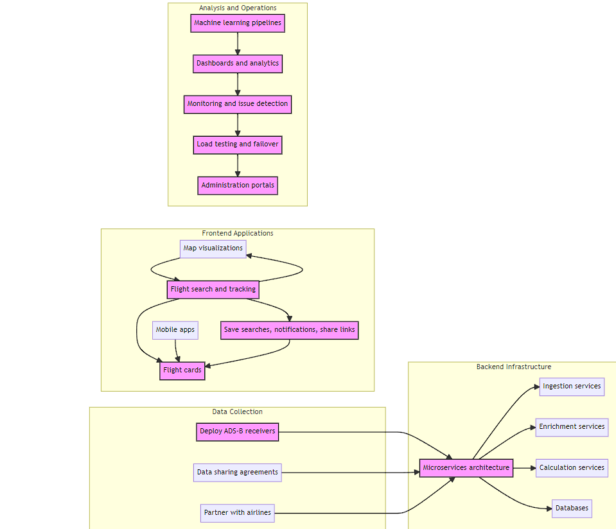
Expected App architecture

Slide 20
Implementation of Existing solution:
ADS-B Data:
Source data from platforms like ADS-B Exchange or FlightRadar24.
User Interface:
Utilize React or Angular for a responsive interface. Incorporate Mapbox or Leaflet for map visuals.
Backend Development:
Set up using Node.js, Python, or Java on cloud platforms (AWS, Azure).
Real-Time Data:
Use WebSocket or Server-Sent Events (e.g., Socket.io) for real-time updates.
Predictive Analytics:
Implement basic machine learning models using TensorFlow or Scikit-learn.
Data Storage:
Opt for scalable databases like PostgreSQL or MongoDB on managed services.
Feedback Mechanism:
Integrate tools like Typeform for user feedback.
Performance
Use CDNs like Cloudflare for faster delivery.

Slide 21
Conclusion

Slide 22
Conclusion
The aviation world is vast, dynamic, and ever-evolving. With the increasing number of flights and a growing community of travellers and enthusiasts, there's a pressing demand for real-time, accurate, and user-friendly flight tracking solutions. The SkyLinker Aero Pathways Application steps into this space with the promise of revolutionizing flight tracking. Harnessing the power of ADS-B data, modern web technologies, and predictive analytics, SkyLinker Aero Pathways offers a seamless and comprehensive flight tracking experience.
As we navigate the skies with SkyLinker Aero Pathways, it's not just about monitoring flights. It's about enhancing the way we interact with aviation data, providing valuable insights, and fostering a deeper connection between the sky and those who admire it.

Slide 23
References

Slide 24
References
https://www.flightstats.com/v2
https://dspace.mit.edu/bitstream/handle/1721.1/67188/758649007-MIT.pdf?sequence=2&isAllowed=y
https://github.com/Ysurac/FlightAirMap

Slide 25
Thank You!

